Slide 1
jQuery

Slide 2
Introduction
jQuery is a lightweight, "write less, do more", JavaScript library.
The purpose of jQuery is to make it much easier to use JavaScript on website.
jQuery takes a lot of common tasks that require many lines of JavaScript code to accomplish, and wraps them into methods that you can call with a single line of code.

Slide 3
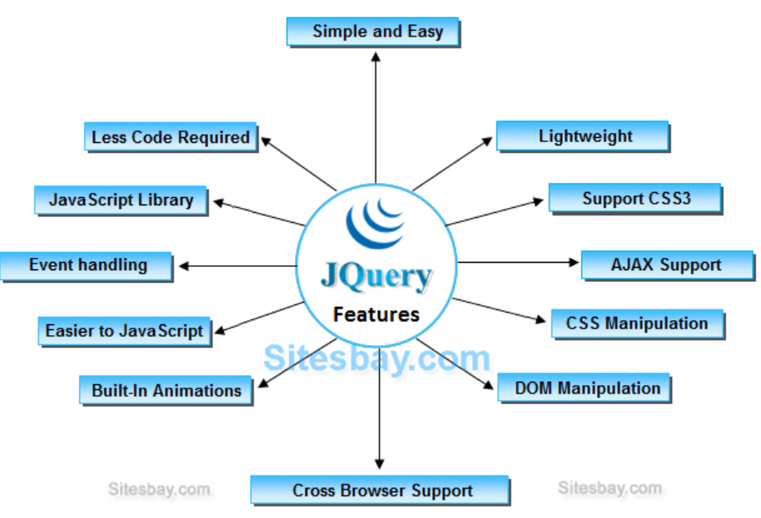
jQuery Features

Slide 4
Why jQuery is required
It facilitates the users to write UI related function codes in minimum possible lines.
It improves the performance of an application.
Browser's compatible web applications can be developed.
It uses mostly new features of new browsers.

Slide 5
Example

Slide 6
$(document).ready() and $()
This event prevent any jQuery code from running before the document is finished loading, It means jquery code load after complete loading of web page.
Suppose if your jquery code load before loading the image in this case you can't get the size of images. In below condition action are failed when method run before the document is fully loaded.
Try to get size of any image which is not loaded yet.
Try to hide element which is not loaded yet.
Document Ready Event prevent any jQuery code from running before the document is finished loading. It means jQuery code load after complete loading of web page.
In place of $(document).ready(), you can use shorthand notation $() only.
OR
$(document).ready(function() { $(function() {
$("p").css("color", "red"); $("p").css("color", "red");
}); });

Slide 7
jQuery Selectors
jQuery Selectors are used to select and manipulate HTML elements. They are very important part of jQuery library.
With jQuery selectors, you can find or select HTML elements based on their id, classes, attributes, types and much more from a DOM.
In simple words, you can say that selectors are used to select one or more HTML elements using jQuery and once the element is selected then you can perform various operation on that.

Slide 8
The $() factory function
Every jQuery selector start with this sign $().
This sign is known as the factory function.
It uses the three basic building blocks while selecting an element in a given document.

Slide 9
The element Selector
The jQuery element selector selects elements based on the element name.
You can select all <p> elements on a page like this:
$(“p”)
<script>
$(document).ready(function(){
$("button").click(function(){
$("p").hide();
});
});
</script>

Slide 10
The #id Selector
The jQuery #id selector uses the id attribute of an HTML tag to find the specific element.
An id should be unique within a page, so you should use the #id selector when you want to find a single, unique element.
To find an element with a specific id, write a hash character, followed by the id of the HTML element:
$(“#test”)
$(document).ready(function(){ $("button").click(function(){ $("#test").hide(); }); });

Slide 11
The .class Selector
The jQuery .class selector finds elements with a specific class.
To find elements with a specific class, write a period character, followed by the name of the class:
$(“.test”)
$(document).ready(function(){ $("button").click(function(){ $(".test").hide(); }); });

Slide 12
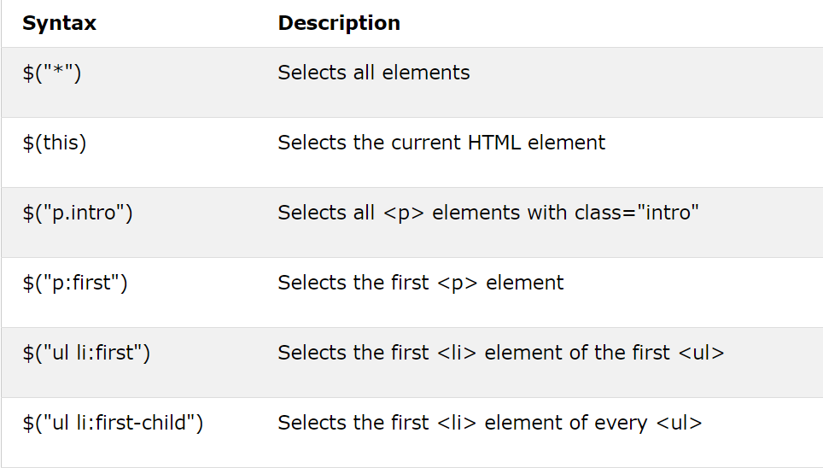
More Examples

Slide 13
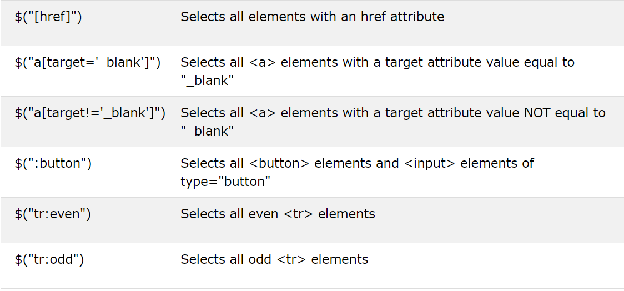
Continue.

Slide 14
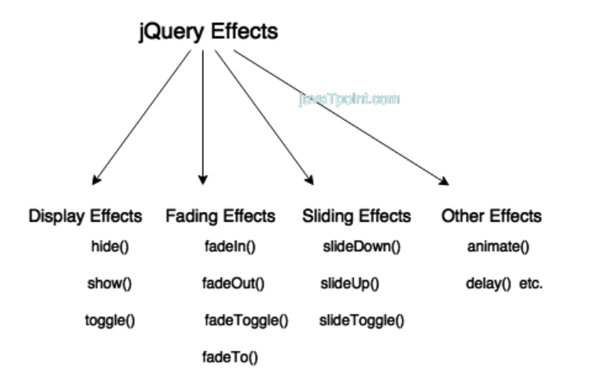
jQuery Effects
jQuery enables us to add effects on a web page. jQuery effects can be categorized into fading, sliding, hiding/showing and animation effects.

Slide 15
jQuery hide()
The jQuery hide() method is used to hide the selected elements.
Syntax:
$(selector).hide();
$(selector).hide(speed, callback);
$(selector).hide(speed, easing, callback);
Where,
speed: It is an optional parameter. It specifies the speed of the delay. Its possible vales are slow, fast and milliseconds.
easing: It specifies the easing function to be used for transition.
callback: It is also an optional parameter. It specifies the function to be called after completion of hide() effect.

Slide 16
callback parameter
A callback function is executed after the current effect is finished.
$(selector).hide( speed, callback );
<script>
$(document).ready(function(){
$("button").click(function(){
$("p").hide("slow", function(){
alert("The paragraph is now hidden");
});
});
});
</script>

Slide 17
easing parameter
Optional. Specifies the speed of the element in different points of the animation.
Default value is "swing". Possible values:
"swing" - moves slower at the beginning/end, but faster in the middle
"linear" - moves in a constant speed

Slide 18
jQuery show()
The jQuery show() method is used to show the selected elements.
Syntax
$(selector).show();
$(selector).show(speed, callback);
$(selector).show(speed, easing, callback);
Where,
speed: It is an optional parameter. It specifies the speed of the delay. Its
possible vales are slow, fast and milliseconds.
easing: It specifies the easing function to be used for transition.
callback: It is also an optional parameter. It specifies the function to be
called after completion of show() effect.

Slide 19
jQuery toggle()
The jQuery toggle() is a special type of method which is used to toggle between the hide() and show() method.
It shows the hidden elements and hides the shown element.
Syntax:
$(selector).toggle();
$(selector).toggle(speed, callback);
$(selector).toggle(speed, easing, callback);
$(selector).toggle(display);
speed: It is an optional parameter. It specifies the speed of the delay. Its
possible vales are slow, fast and milliseconds.
easing: It specifies the easing function to be used for transition.
callback: It is also an optional parameter. It specifies the function to be
called after completion of toggle() effect.
display: If true, it displays element. If false, it hides the element.

Slide 20
jQuery fadeIn()
jQuery fadeIn() method is used to fade in the element.
Syntax:
$(selector).fadein();
$(selector).fadeIn(speed,callback);
$(selector).fadeIn(speed, easing, callback);
Where,
speed: It is an optional parameter. It specifies the speed of the delay.
Its possible vales are slow, fast and milliseconds.
easing: It specifies the easing function to be used for transition.
callback: It is also an optional parameter. It specifies the function to
be called after completion of fadein() effect.

Slide 21
jQuery fadeOut()
The jQuery fadeOut() method is used to fade out the element.
Syntax:
$(selector).fadeOut();
$(selector).fadeOut(speed,callback);
$(selector).fadeOut(speed, easing, callback);
where,
speed: It is an optional parameter. It specifies the speed of the delay.
Its possible vales are slow, fast and milliseconds.
easing: It specifies the easing function to be used for transition.
callback: It is also an optional parameter. It specifies the function to
be called after completion of fadeOut() effect.

Slide 22
jQuery fadeToggle()
jQuery fadeToggle() method is used to toggle between the fadeIn() and fadeOut() methods.
If the elements are faded in, it will make them faded out and if they are faded out it will make them faded in.
Syntax:
$(selector).fadeToggle();
$(selector).fadeToggle(speed,callback);
$(selector).fadeToggle(speed, easing, callback);

Slide 23
jQuery fadeTo()
jQuery fadeTo() method is used to fading to a given opacity.
Syntax:
$(selector).fadeTo(speed, opacity);
$(selector).fadeTo(speed, opacity, callback);
$(selector).fadeTo(speed, opacity, easing, callback);
speed: It specifies the speed of the delay. Its possible vales are slow,
fast and milliseconds.
opacity: It specifies the opacity. The opacity value ranges between 0
and 1.
easing: It specifies the easing function to be used for transition.
callback: It is also an optional parameter. It specifies the function to
be called after completion of fadeToggle() effect.

Slide 24
jQuery slideDown()
jQuery slideDown() method is used to slide down an element.
Syntax:
$(selector).slideDown(speed);
$(selector).slideDown(speed, callback);
$(selector).slideDown(speed, easing, callback);

Slide 25
jQuery slideUp()
jQuery slideDown() method is used to slide up an element.
Syntax:
$(selector).slideUp(speed);
$(selector).slideUp(speed, callback);
$(selector).slideUp(speed, easing, callback);

Slide 26
jQuery slideToggle()
jQuery slideToggle () method is used to toggle between slideUp() and slideDown() method.
If the element is slide down, it will slide up the element and if it is slide up, it will slide down.
Syntax:
$(selector).slideToggle(speed);
$(selector).slideToggle(speed, callback);
$(selector).slideToggle(speed, easing, callback);

Slide 27
jQuery animate()
The jQuery animate() method provides you a way to create custom animations.
Syntax:
$(selector).animate({params}, speed, callback);
Here, params parameter defines the CSS properties to be animated.
The speed parameter is optional and specifies the duration of the
effect. It can be set as "slow" , "fast" or milliseconds.
The callback parameter is also optional and it is a function which is executed after the animation completes.

Slide 28
jQuery delay()
The jQuery delay() method is used to delay the execution of functions in the queue.
It is a best method to make a delay between the queued jQuery effects.
The jQUery delay () method sets a timer to delay the execution of the next item in the queue.
Syntax:
$(selector).delay (speed, queueName)
Where,
speed: It is an optional parameter. It specifies the speed of the delay. Its
possible vales are slow, fast and milliseconds.
queueName: It is also an optional parameter. It specifies the name of the
queue. Its default value is "fx" the standard queue effect.

Slide 29
Difference
.fadeIn(duration) and .fadeOut(duration) animate the percentage of opacity in a duration. During the fading animation the place of element is fully occupied however at the end of .fadeOut() the place will be removed at once.
.show(duration) and .hide(duration) animate the size of element (also the opacity) to 100% and 0% and the place of elements is also animated in that duration.
Similarity: The element would disappear immediately in both .hide() and .fadeOut() when duration=0 and would appear immediately in .show() and .fadeIn() when duration=0.

